Slide 1

The OPERA Experiment
Jiro Kawada
Albert Einstein Center for Fundamental Physics
LHEP, University of Bern
on behalf of the OPERA Collaboration
Workshop on Nuclear Track Emulsion and its Future
14-18 October 2013
Predeal, Romania

Slide 2
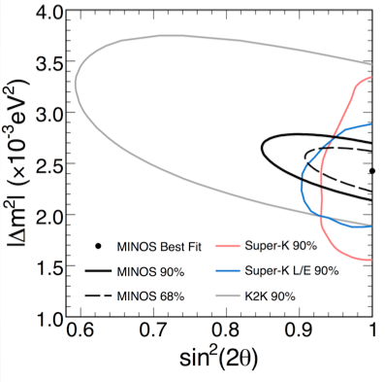
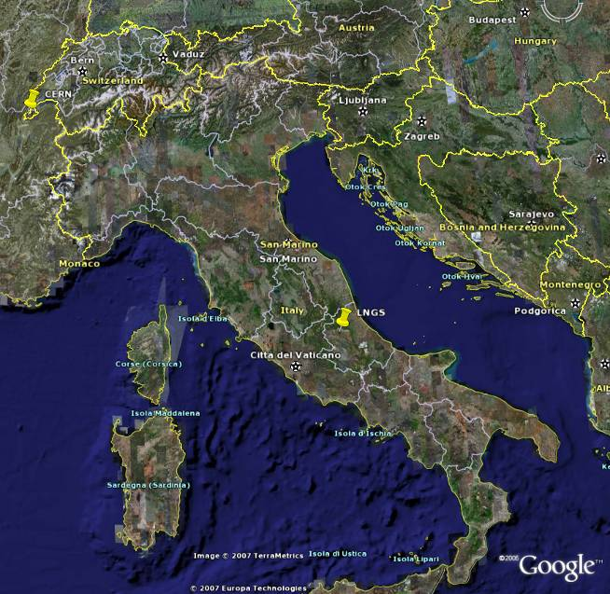
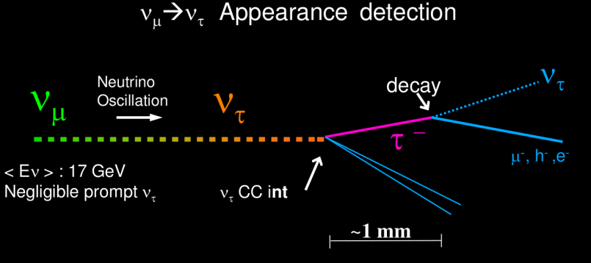
OPERA experiment
Purpose:
- Long baseline(730km) neutrino oscillation in CNGS(CERN Neutrinos to Gran Sasso) νμ beam
• search for ν_{μ} → ν_{τ} oscillation in appearance mode
• search for ν_{μ} → ν_{e} oscillation
Covers the region indicated by Super-K, K2K & MINOS

Slide 3
Long History of emulsion in neutrino physics
Target Mass
• 1978-1983 Fermilab E531 ~ 100kg
charm physics, ν_{μ}→ν_{τ} oscillation
• 1990-2000 CERN WA95 CHORUS ~ 1 ton
ν_{μ}→ν_{τ} oscillation, charm physics
• 1994-2001 Fermilab E872 DONUT ~ 1 ton
First ν_{τ} observation
• 2008- CERN CNGS01 OPERA 1250 ton
ν_{μ}→ν_{τ} oscillation, ν_{μ}→ν_{e} oscillation

Slide 4




The OPERA Collaboration
OPERA collaboration
Belgium
ULB Brussels
Italy
Bari
Bologna
LNF Frascati
L’Aquila
LNGS
Naples
Padova
Rome
Salerno
Korea
Jinju
Croatia
IRB Zagreb
Russia
INR RAS Moscow
LPI RAS Moscow
ITEP Moscow
SINP MSU Moscow
JINR Dubna
France
LAPP Annecy
IPHC Strasbourg
Switzerland
Bern
Japan
Aichi edu.
Kobe
Nagoya
Toho
Nihon
Germany
Hamburg
Israel
Technion Haifa
Turkey
METU Ankara
（11 countries、28Institutes、~140 researchers）

Slide 5
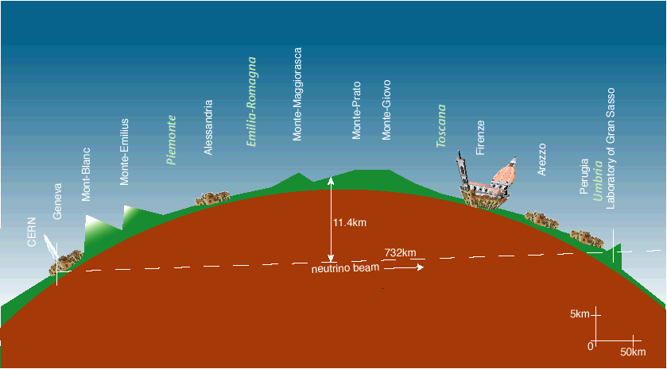
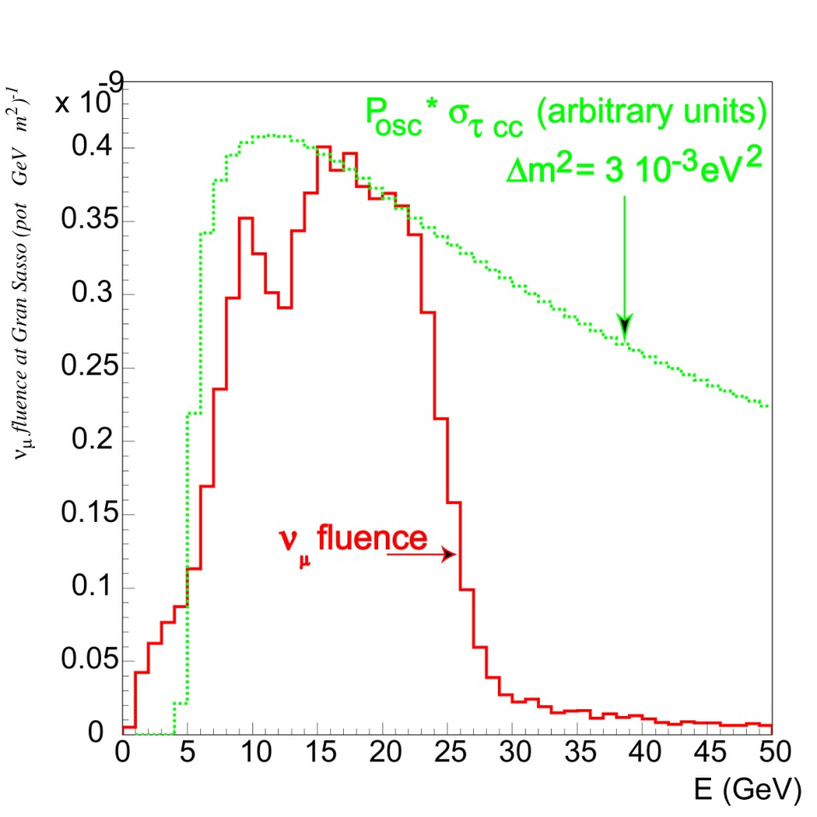
The CNGS beam
CERN
730 km
LNGS
Beam main features
L | 730 km
<E_{ν}> | 17 GeV
(ν_{e}+ν_{e})/ν_{μ} interactions | 0.87%
ν_{μ} / ν_{μ} interactions | 2.1%
ν_{τ} prompt | negligible

Slide 6
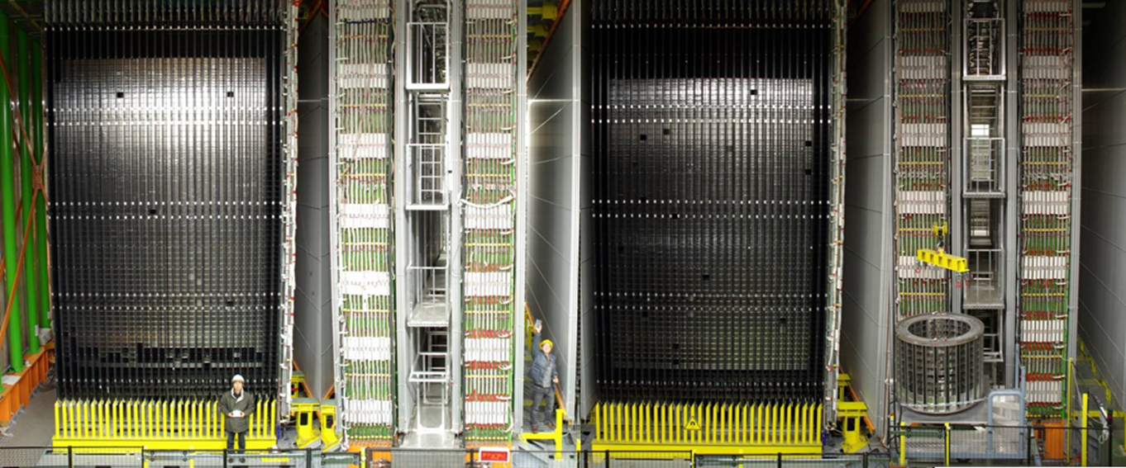

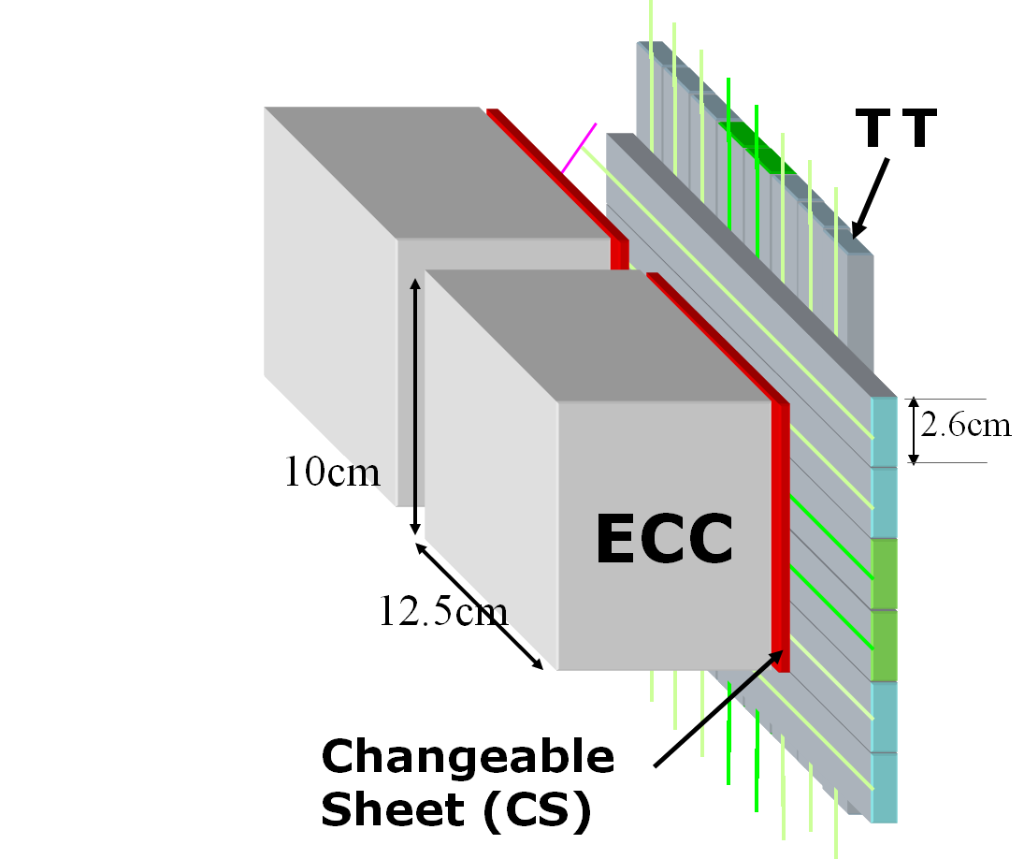
OPERA detector
Total 1.25 kton, ~150000 ECC bricks
SM1
SM2
Brick walls
+ Target Tracker(TT)
Muon Spectrometer
RPC+ Drift Tubes (HPT)
730km
ν_{μ} beam
~20m
Target Tracker(TT)
Target area
Target area
Muon Spectrometer
Muon ID, momentum and charge measurement

Slide 7
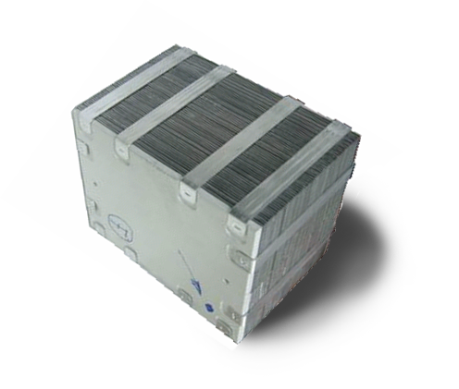
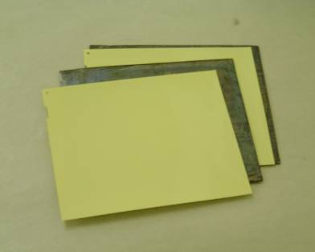
OPERA ECC
Pb(1mm) / Nuclear Emulsion (OPERA film) Sandwich
1 mm
τ
ν
Pb
Nuclear emulsion
56Lead plates + 57films = 8.3 Kg (10 X₀)
In total 150,000 Bricks!!
100mm
125mm

Slide 8
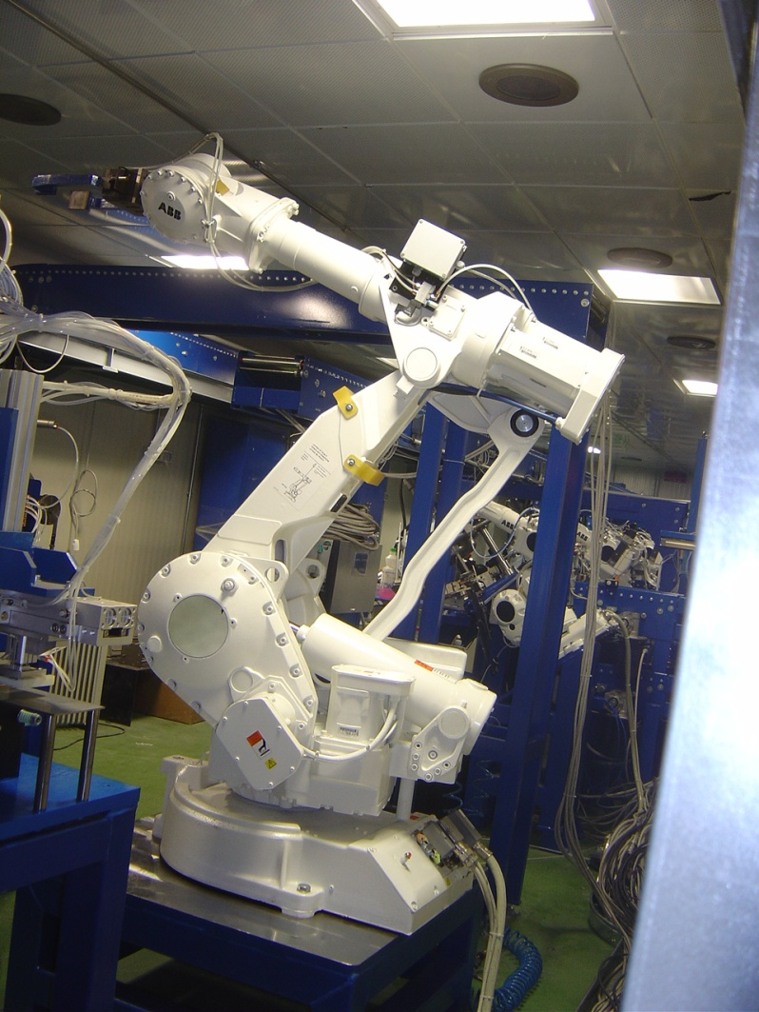
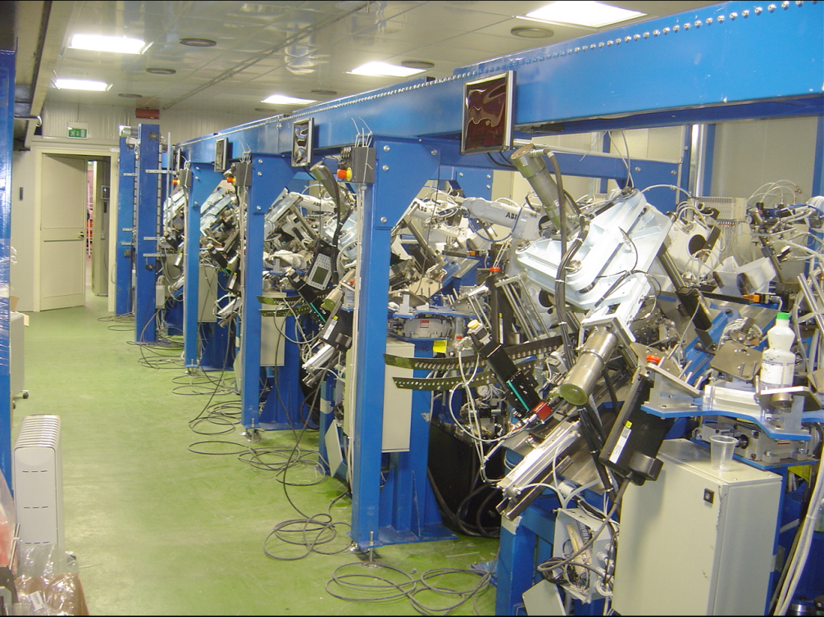
Brick Assembly Machine (BAM) at LNGS
Robots produce bricks
at a rate of ∼ 700 bricks / day

Slide 9

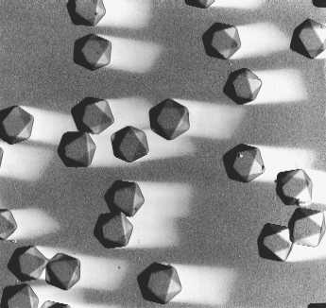
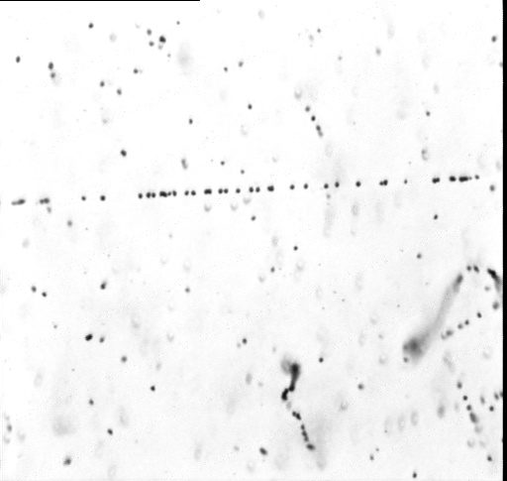
OPERA film (made by FUJI Film)
Emulsion Layer (44 microns)
AgBr crystal size
= 0.2 micron
Intrinsic resolution
= 50 nm
Plastic Base (205 microns)
Emulsion Layer
Automatic machine pouring by Fuji
σ = 50nm
15 grains/44 microns
MIP
electron ～100 keV
20 μm
dx
M.I.P. Track
9
Notes:
9
9
EMULSION FILMS: IN 50 MICRONS 15-20 SPACE POINTS WITH SUB-MICROMETRIC ACCURACY
Probability that a base-tracks is not found is 0,8% (eff >99%)

Slide 10
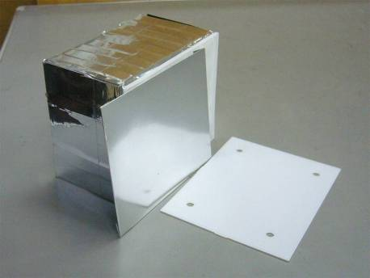

Changeable Sheets (CS)
After taking out bricks, Only 2 films are developed and scanned
*Changeable sheets, easy to detach
*Extremely low background with special treatment
→ Minimize the loss of target mass , Save analysis time

Slide 11
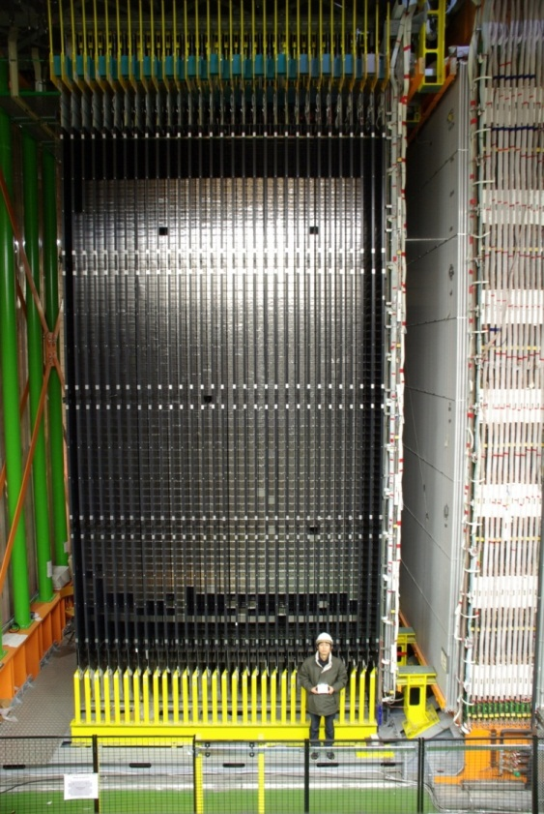
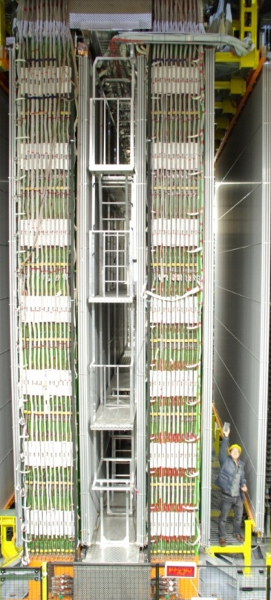
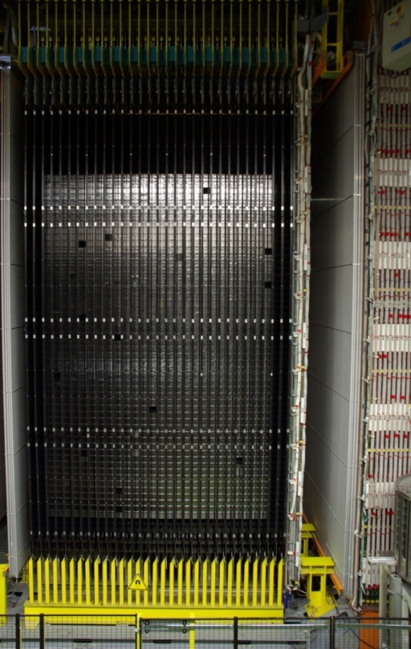
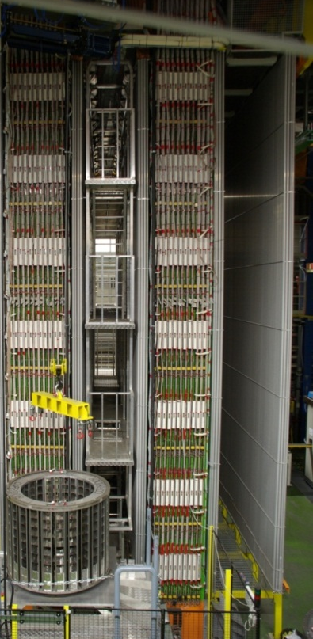
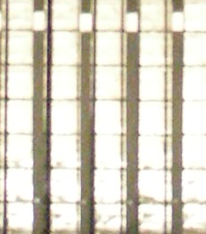
The OPERA detector
Emulsion +
Target Tracker
Muon
spectrometer
Emulsion +
Target Tracker
Muon
spectrometer
OPERA emulsion film

Slide 12
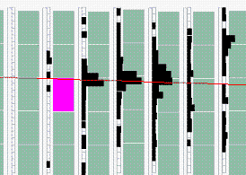
Brick selection by CS
If no track was confirmed by CS,
Next probable ECC is extracted and CS scanned .
２

Slide 13
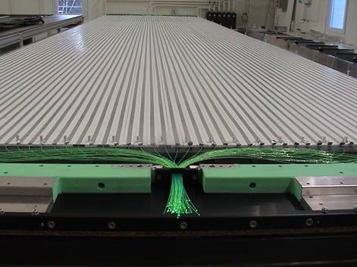
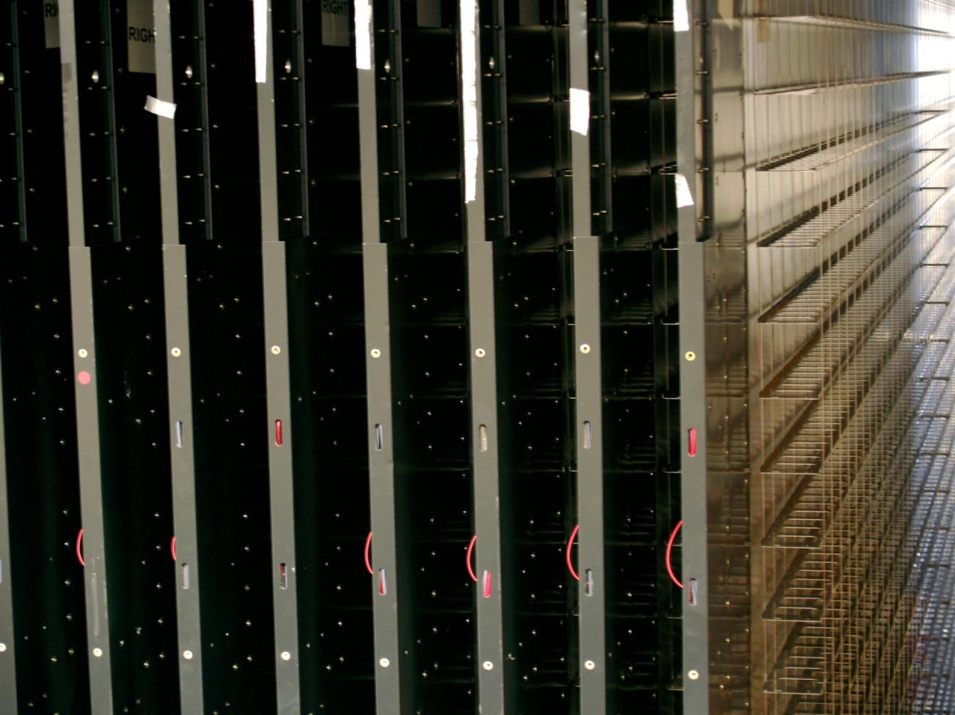
Scintillator Strips Target Tracker
Module: 64 scintillator strips
Signal transmitted by WLS fibers
Read at both ends by 64-PMT
~ 99% detection efficiency ⇒ trigger
Position accuracy: ~ 8 mm ⇒ brick location
Probability map of event location in bricks

Slide 14
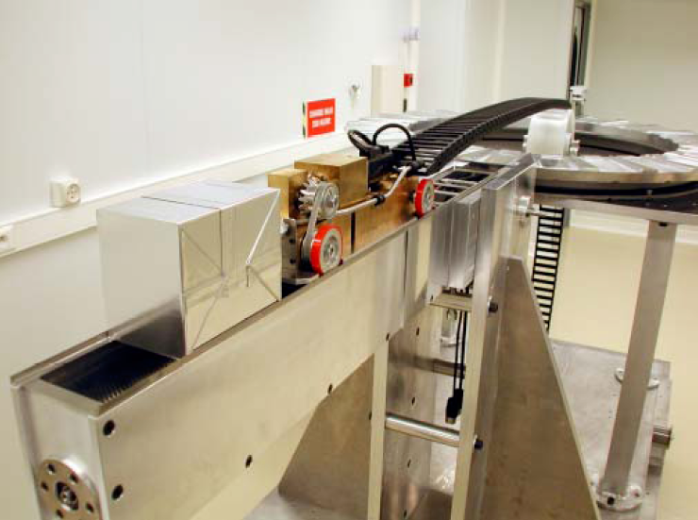
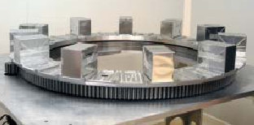
Brick Manipulator System (BMS)
Robot for
brick insertion (target filling)
and removal (during run)
Ventouse Vehicle
Carousel mechanism
Brick

Slide 15
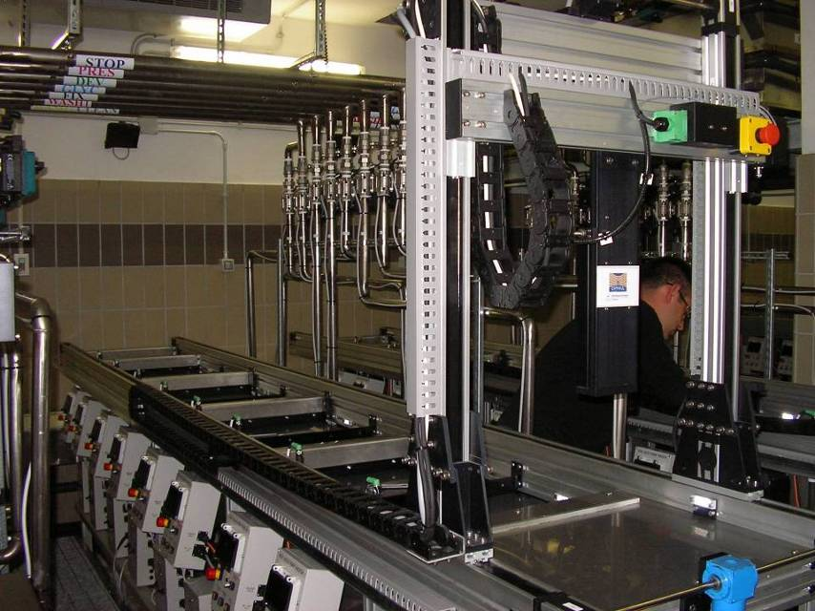
Automatic developing system
Capability ～20 ECC/day

Slide 16
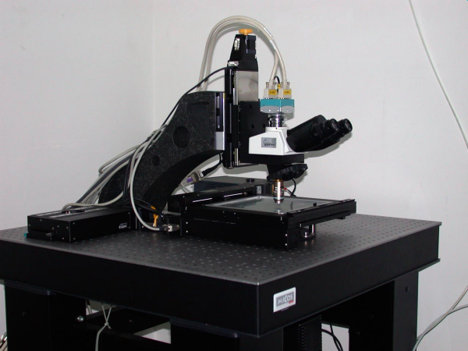
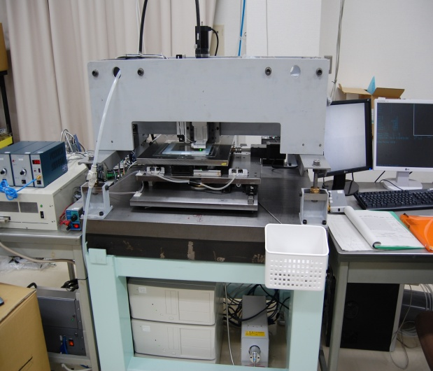
OPERA Emulsion scanning system
European Scanning System
Super-UltraTrackSelector
High speed automatic microscopes:
~ 200 cm² emulsion film surface/hour/facility
Based on state of the art technologies:
precision mechanics, high-speed CMOS, pattern recognition, image analysis
Data flow: ∼ 1 GB/s/facility

Slide 17
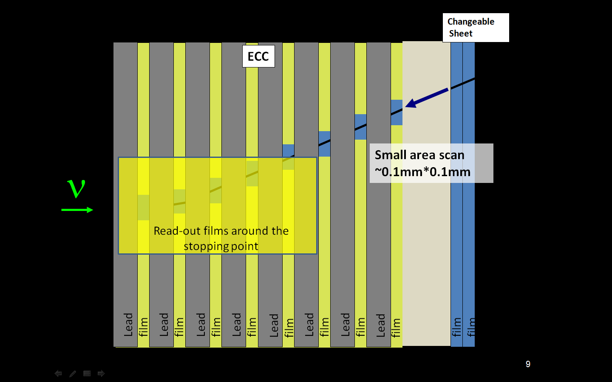
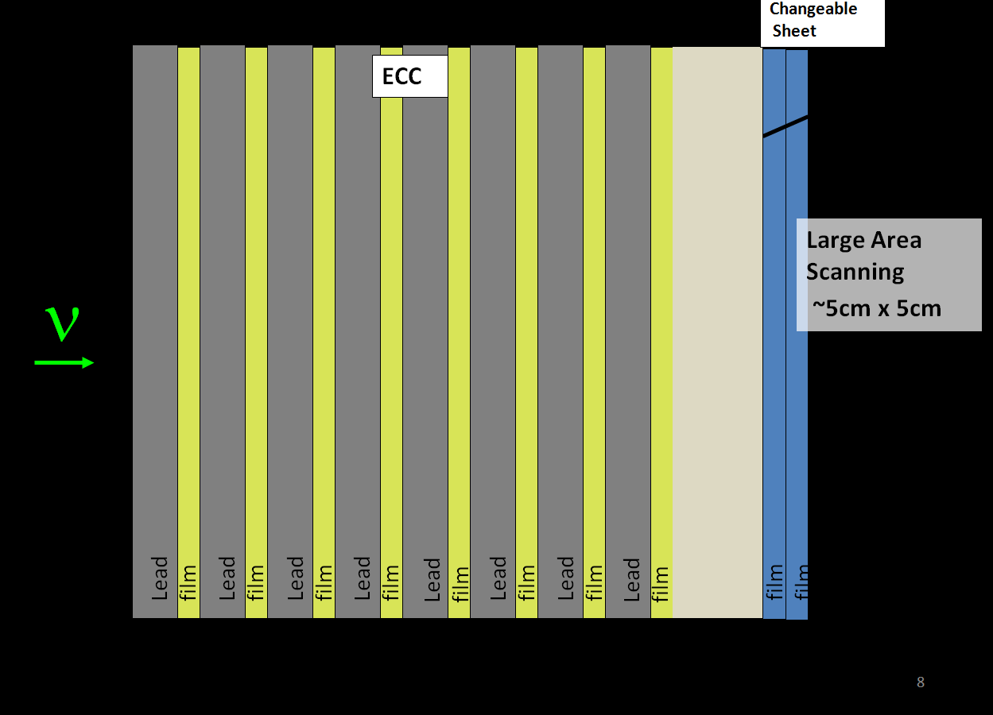
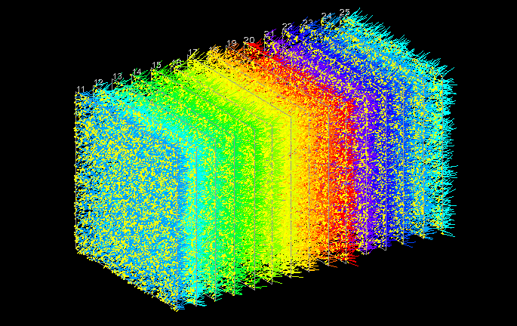
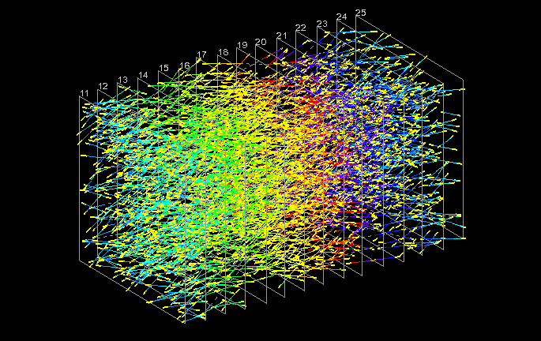
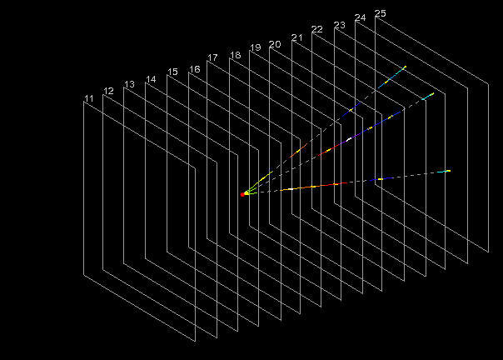
Neutrino interaction location in ECC
Step 1: CS scanning
Step 2-4: CS-ECC connection, ScanBack, Volume data taking
Step 5-6: validation of neutrino interaction vertex and decay search for short lived particles

Slide 18
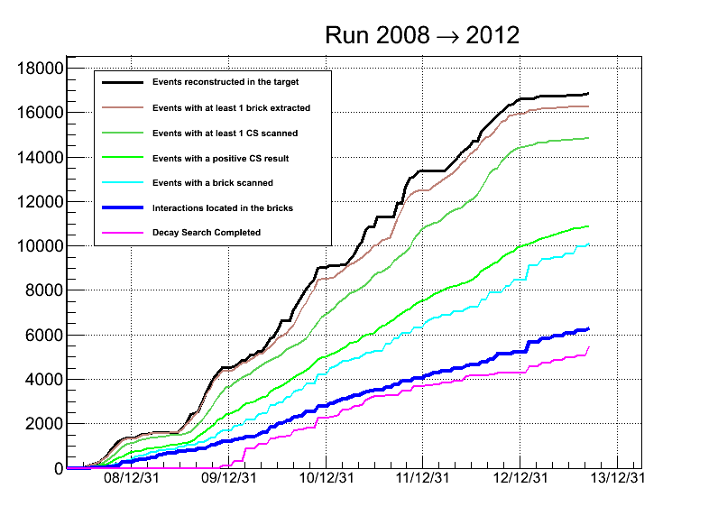
Status of data analysis
2012
Extracted
CS scanned
2011
CS track found
ECC scanned
2010
ν int. found
Decay searched
2009
2008
6299 located interactions
5497 decay search

Slide 19
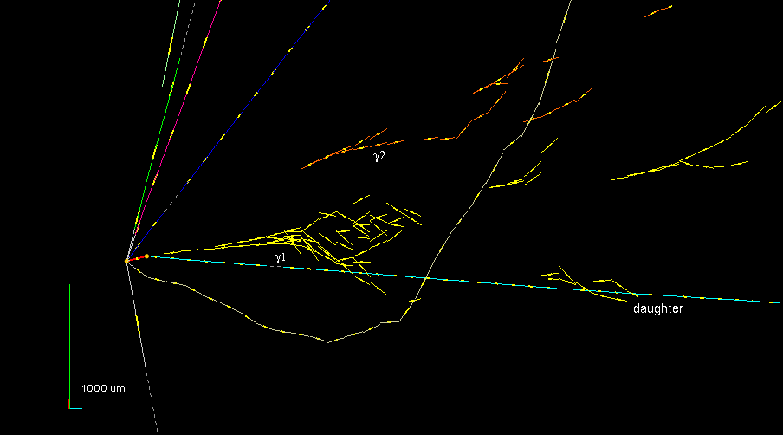
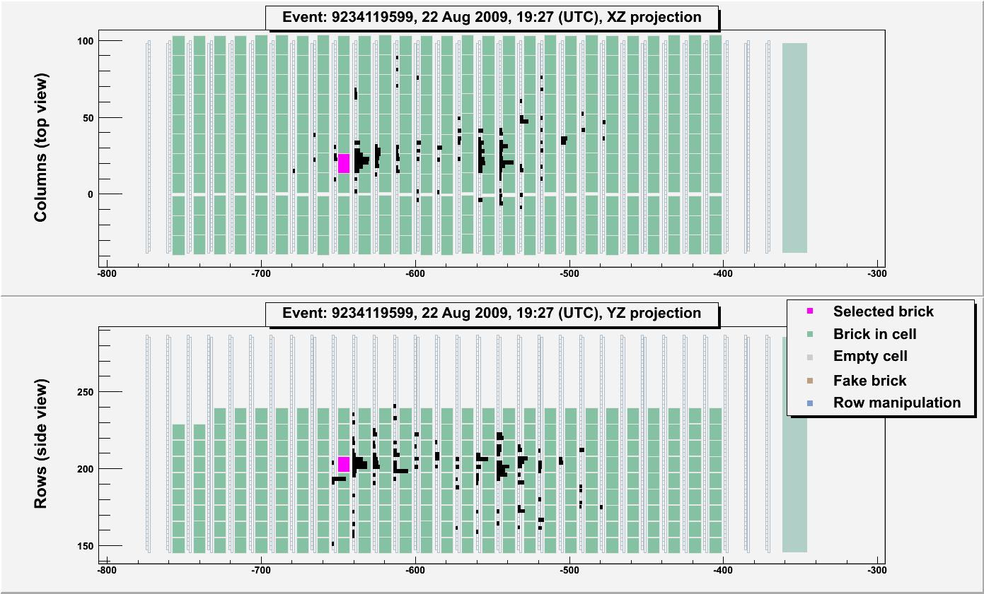
First ν_{τ} candidate Event
VARIABLE | AVERAGE | Selection criteria
kink (mrad) | 41 ± 2 | >20
decay length (μm) | 1335 ± 35 | within 2 lead plates
P daughter (GeV/c) | 12 ⁺⁶₋₃ | >2
Pt (MeV/c) | 470 ⁺²³⁰₋₁₂₀ | >300 (γ attached)
missing Pt (MeV/c) | 570 ⁺³²⁰₋₁₇₀ | <1000
φ (deg) | 173 ± 2 | >90
Published: Physics Letters B, Vol. 691(138-145)

Slide 20
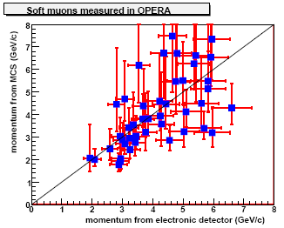
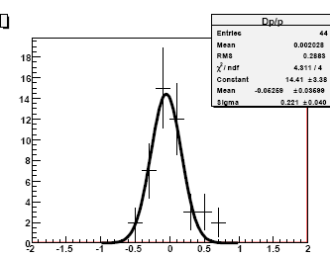
Momentum measurement in ECC
Δp/p
σ = (22±4)%

Slide 21
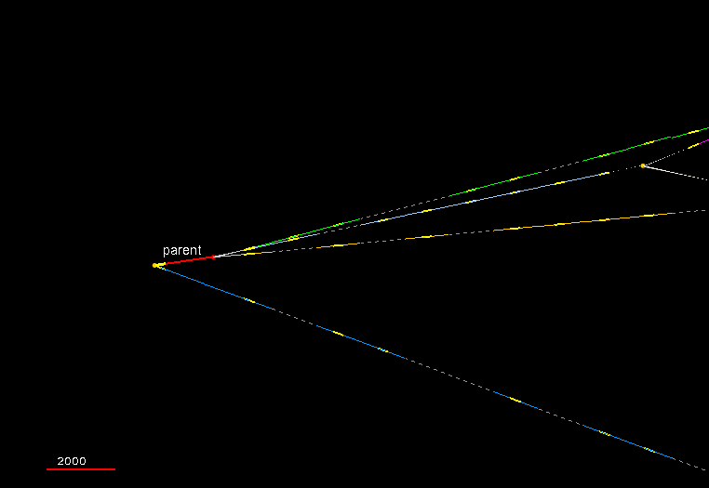
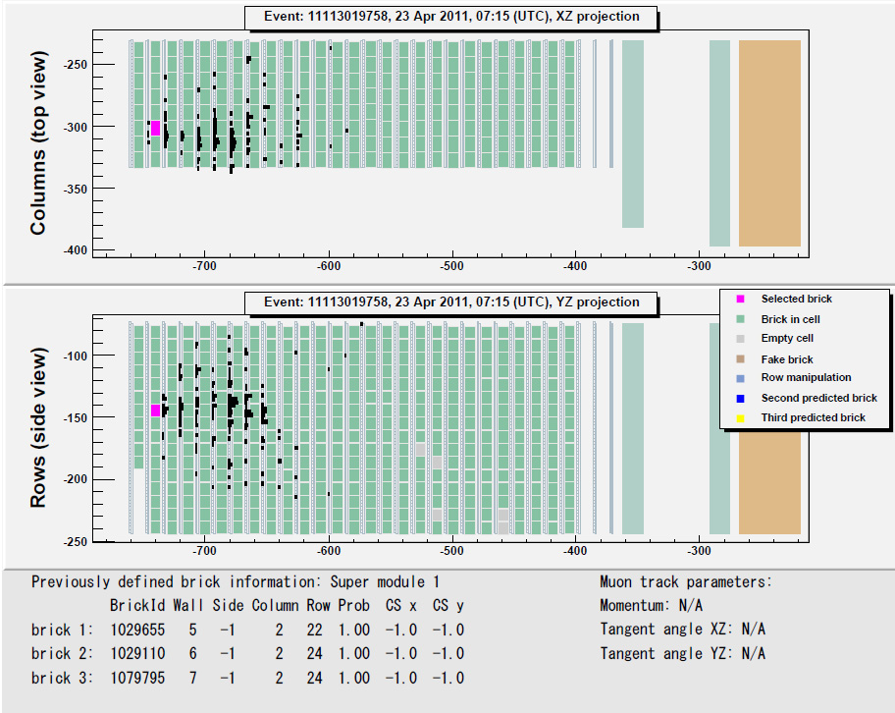
Second ν_{τ} Candidate Event
animation
Track | Momentum （1σ interval） [ GeV/c] | Particle ID
Primary track | 2.8 (2.1-3.5) | Hadron
Daughter-1 | 6.6 （5.2 - 8.6） | Hadron
Daughter-2 | 1.3 （1.1 -1.5） | Hadron
Daughter-3 | 2.0 (1.4 - 2.9) | Hadron
2000 μm

Slide 22

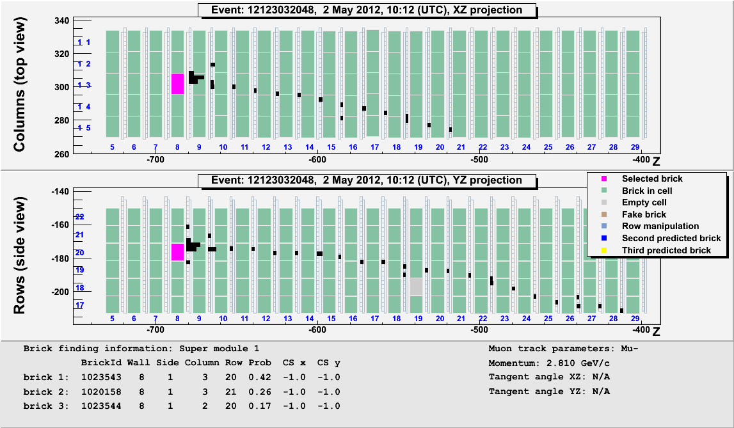
Third ν_{τ} Candidate Event
Track | Momentum （1σ interval） [ GeV/c] | Particle ID
Primary track | 0.9±0.2 | Hadron
Daughter-1 | 2.8±0.2 | Muon
Gamma ray | 2.9±0.3 | γ

Slide 23
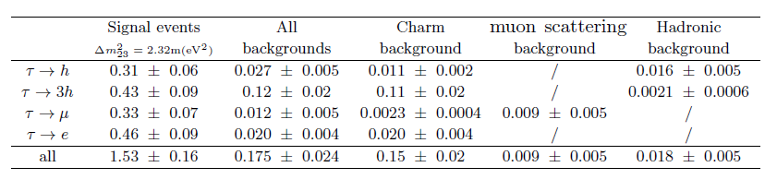
ν_{μ}→ν_{τ} oscillation analysis
● 3 observed events in τ → h, τ → 3h, τ → μ channels.
● 3.4σ significance of non-null observation
Expected Signal and Background for 2-tau(τ → h, τ → 3h)

Slide 24
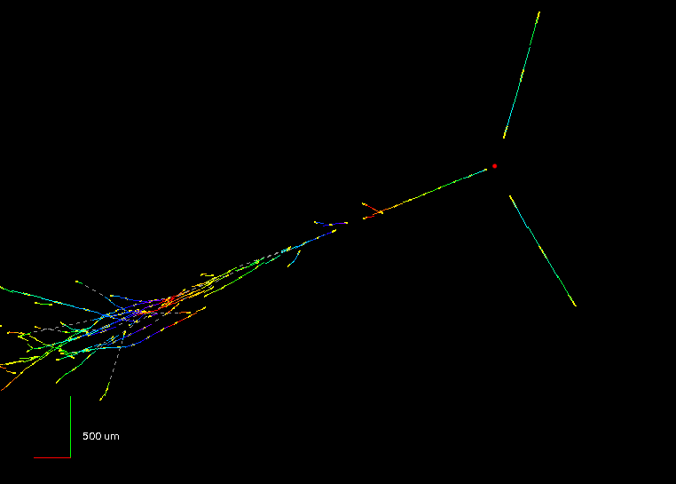
ν_{e} appearance search
ν_{µ} → ν_{e} appearance search in 2008+2009 sample (5.25 x 10¹⁹ PoT)
E_{ν} = 15.6 GeV

Slide 25
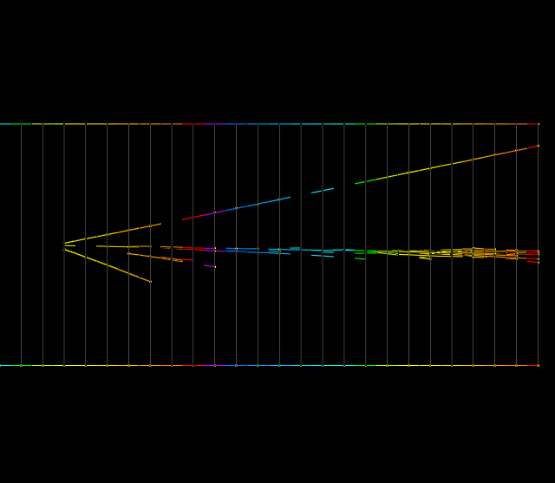
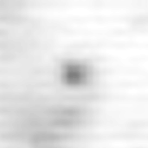

Electron Identification in ECC
hadron
ν_{e}
electron
Microscopic image from
the view of the beam axis
γ−>e+e-
hadron
Electromagnetic shower
γ−>e⁺e⁻
electron
4.1X₀
1μm
Primary electron track observed as an isolated track,
not as a pair tracks
fine position resolution of nuclear emulsion and fine segmentation (track reconstruction
each 1mm lead plate (0.18X₀)) in ECC
−> separate electron from γ−>e+e-
Electromagnetic shower developed in ECC
−> separate electron from pion
Notes:
実際のイベントの絵を見せる、
BGについても話す

Slide 26
Analysis of 2008-2009 data sample
19 ν_{e} events observed out of 505 0μ events
Systematic Uncertainty
1：Beam flux 10%
2：Detection efficiency
10%(Eν>=10GeV)
20%(Eν<10GeV)
Expected number of background ν_{e} events :19.8±2.8(sys)
−> Observation agrees with background expectation
（prompt ν_{e}, NC with π⁰, τ−>e）
Published: JHEP07(2013)004

Slide 27
OPERA ν_{μ}−>ν_{e} oscillation results
(in 2008+2009 data set)
3 flavor mixing model for standard
oscillation
Upper limit (90%C.L.) @Δm²₁₃=2.32 x 10⁻³（eV²）
sin²(2θ₁₃) = 0.44
N_{expBG} = 4.6±0.7(sys), N_{obs} = 4 (E_{ν}__{rec}<20GeV)
Observation is compatible with non-oscillation hypothesis
Notes:
27
27
Dm2_13=Dm2_23 変数として解析
Dm2_12は定数

Slide 28
Summary
OPERA successfully collected data from 2008 to 2012. CS/ECC analysis is going on.
A total number of 18.0 x 10¹⁹ p.o.t integrated.
ν_{μ} → ν_{τ} oscillation results:
● 3 events found in the analyzed sample
● 3.4σ significance
● Likelihood method is under study
ν_{μ} → ν_{e} oscillation results:
● Upper limit sin²(2θ₁₃) < 0.44 at 90% CL

Slide 29
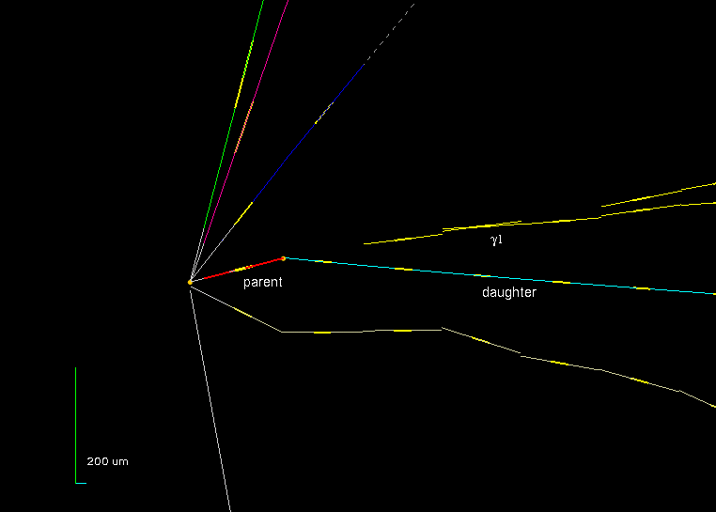
Thank you

Slide 30
Backup

Slide 31
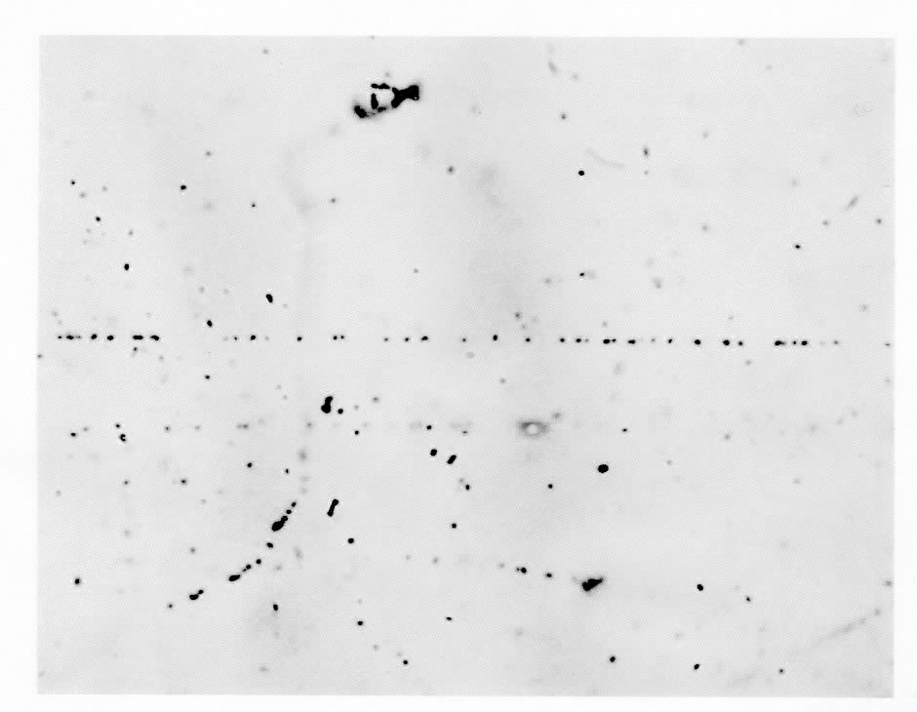
Intrinsic position resolution
Cross sectional view of an emulsion layer
Ag grain after development
M.I.P. Track
dx
M.I.P. Track
σ = 0.06μm
Fog
Compton Electron
100μm
30grains/100μm
grain diameter ~ 0.6μm
One Emulsion Layer = vector chamber with 60nm position resolution
& ~1mrad Angular resolution (100micron layer)

Slide 32
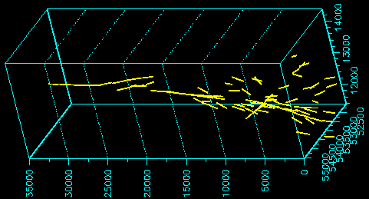
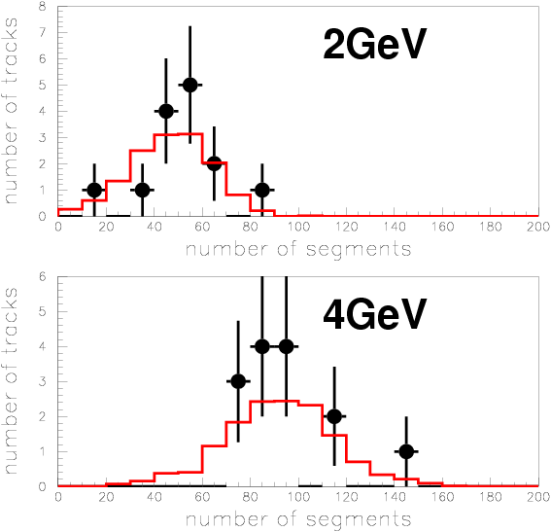
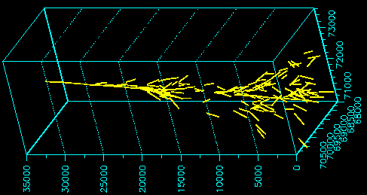
Electron energy measurement
Test exp. @ CERN
MC
Data
Energy determination
by calorimetric method
( in study)
@ a few GeV

Slide 33
ν_{e} energy estimation
Reconstruct the energy
deposition (E_{vis}) in Target Tracker.
Obtain the fitting parameter from
E_{vis} to reconstructed ν_{e} energy
(E_{νe_rec}) through the MC simulation.
Estimate the E_{νe_rec}
Eν reconstructed by TT (MC) [GeV]
Eν of MC truth [GeV]
Energy resolution
ΔE / E = 0.37 + 0.74 / sqrt(E)

Slide 34
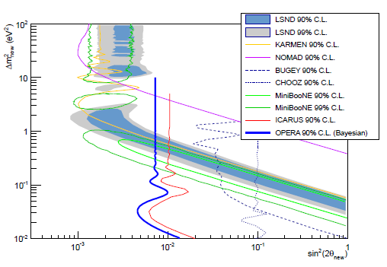
OPERA ν_{μ}−>ν_{e} oscillation results
(in 2008+2009 data set)
2 flavor mixing model for non-standard oscillation with a dominant mass scale
(analysis for LSND-MiniBooNE observation results)
N_{expBG} = 9.4±1.3(sys)
N_{obs} = 6
(E_{ν}__{rec}<30GeV)
Upper limit (90%C.L.) @largeΔm²
sin²(2θ_{new}) = 7.2 x 10⁻³
Notes:
34
34
ICARUS について

